Slide 1
Nematocyst Classification
Gautam Shine, Tuba Opel, Eric Cheng

Slide 2
The Problem
Is this particular blob like these blobs or those blobs?
We need descriptors – “features” in machine learning parlance

Slide 3
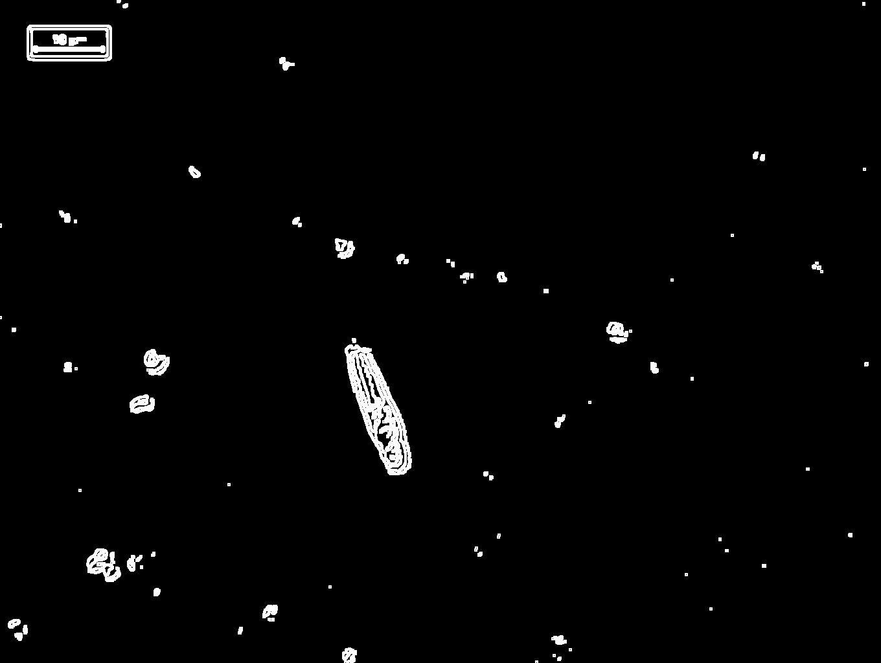
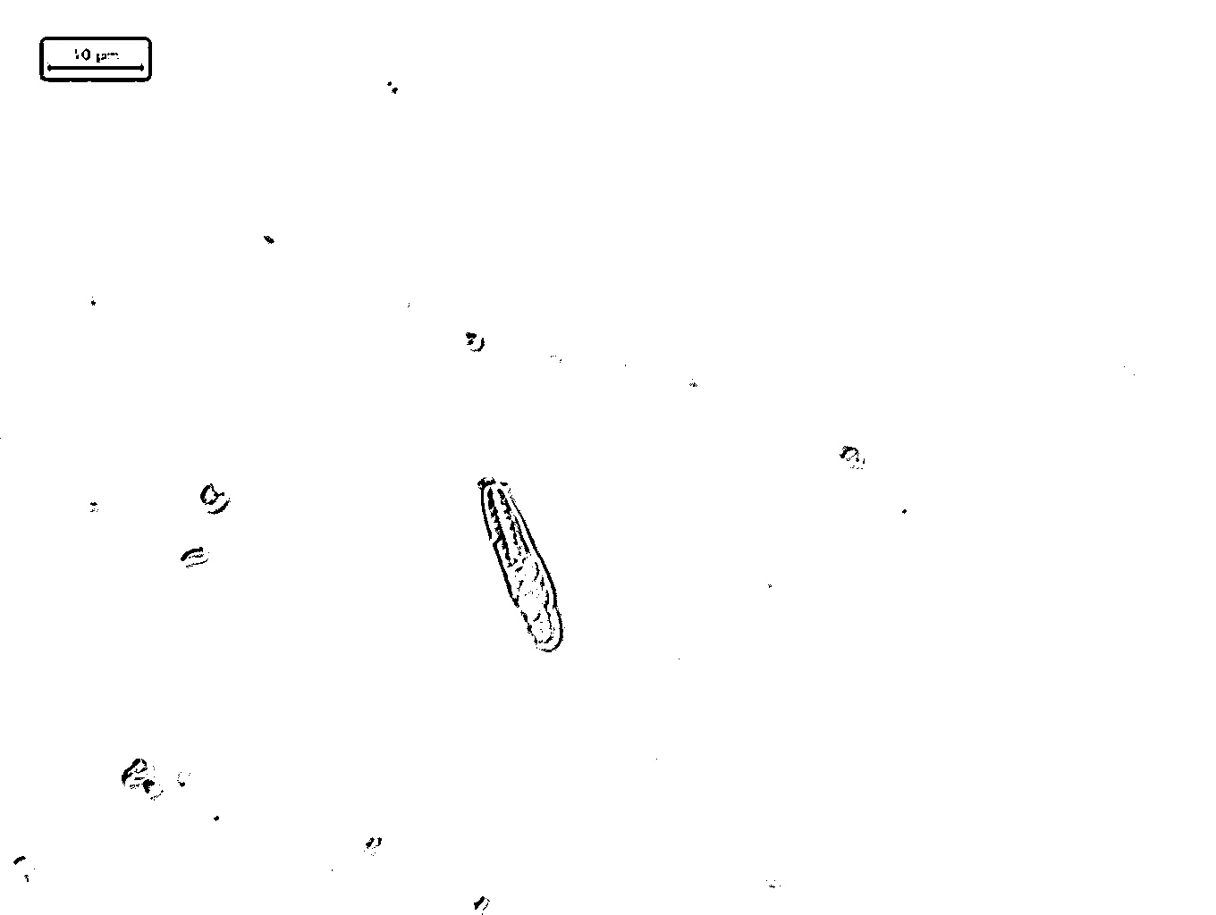
Approach #1: Designed Features
Example: edge detection, thresholding
Effective in some domains, e.g. face detection with Haar features
Nobody has bothered to tune them for nematocysts

Slide 4
Approach #2: Learned Features
Convolutional networks: image in, vector out
Raw RGB values to something more semantic (to machines)
Source: MathWorks

Slide 5
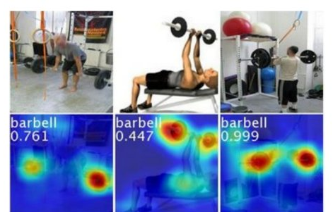
Approach #2: Learned Features
Do we lose interpretability?
It’s possible to back out “activation” or “attention”
This is where the machine is looking
Source: B. Zhou CVPR ‘16

Slide 6
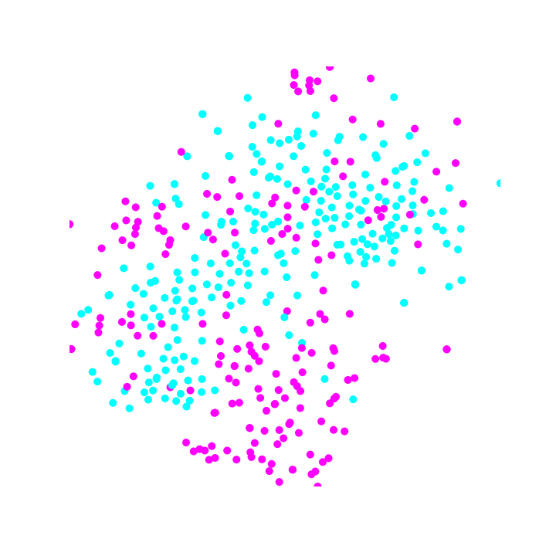
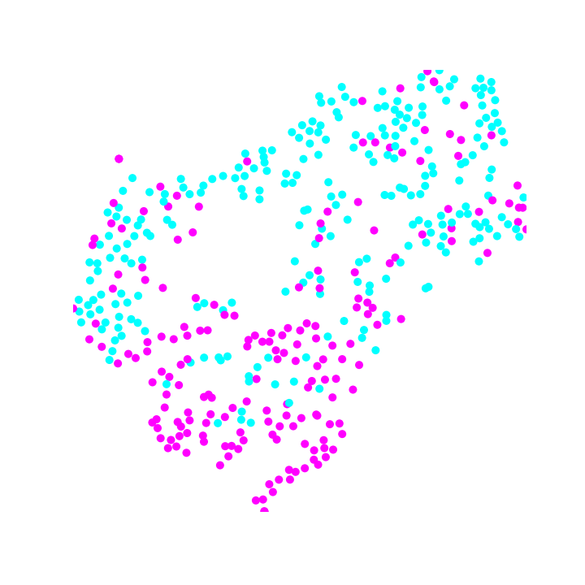
Approach #2: Learned Features
ResNet50 w/ some fine-tuning achieves 60% accuracy
2D subspace projection shows lack of separation
Pure t-SNE
(preserves
all info)
4 PC + t-SNE
(throwing out
>80% of info)

Slide 7
What Does This Mean?
The usual machine learning issues apply:
Overfitting
Parameter tuning
Low number of training samples
Messy data

Slide 8
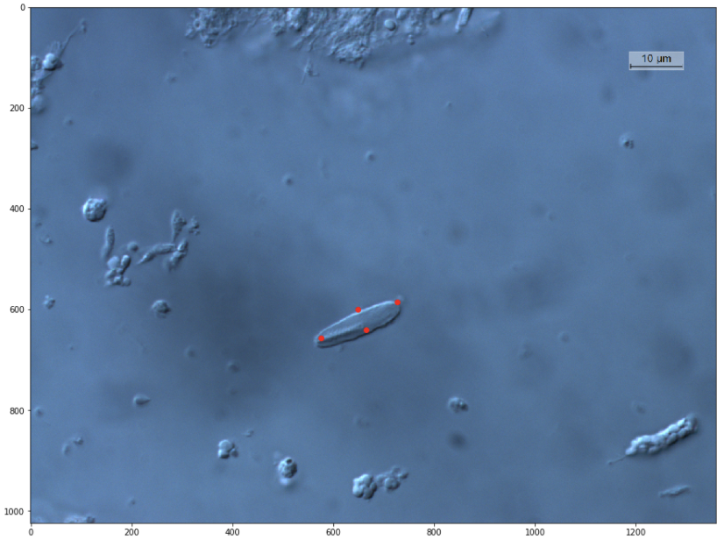
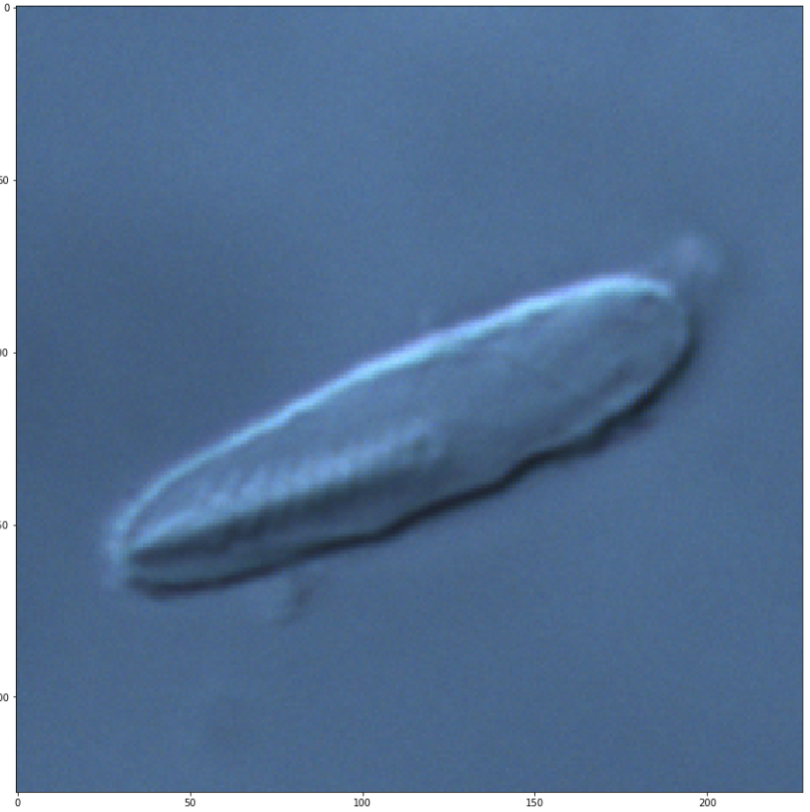
Image Manipulation
Clean up the data with cropping + rotation

Slide 9
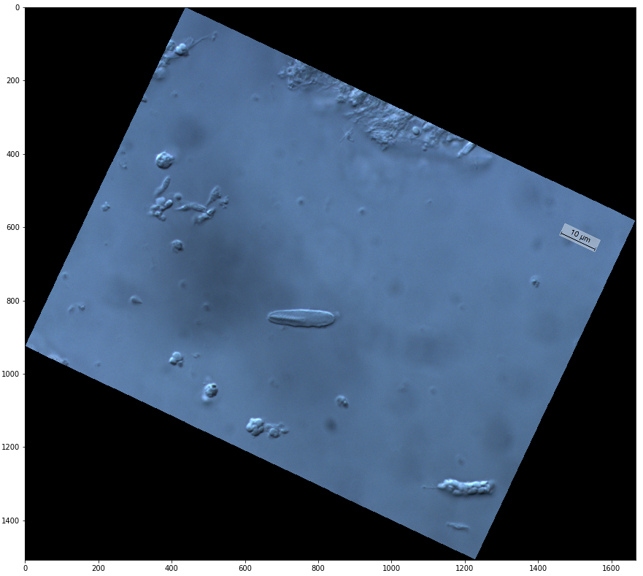
Image Manipulation
Clean up the data with cropping + rotation (4 by 16 microns)

Slide 10
Future Work
Feed in larger amounts of cleaned-up data
Monotonic improvement
Takes some work by humans
“Unsupervised” learning with ALL the data
Make use of Luciana’s 1 million unlabeled images
Learn more accurate representations of nematocytes

